Slide 1
Mphasis
Project Name: Hospital Management System
GROUP NO: 3
Group Members:
2487055 Bhabna Bhabasmita Nayak
2484536 Bhagyashri Ravindrakumar Bagal
2485051 Birudala Aswini
2484937 Boddepalli Alekhya
2481325 Bulla Chandra Mukesh
2486960 C Sadhana
2487666 Chukkaluru Pavithra
2483854 Devadharshini X
2484902 Dhivya Jagadeesaan
2483821 Dinesh Kumar Mandal (Group Leader)

Slide 2
Login
&
Registration
Backend

Slide 3
Overview
User can signup new account, or login with username password
By user’s role(Admin, User), we authorize the user to access resources

Slide 4
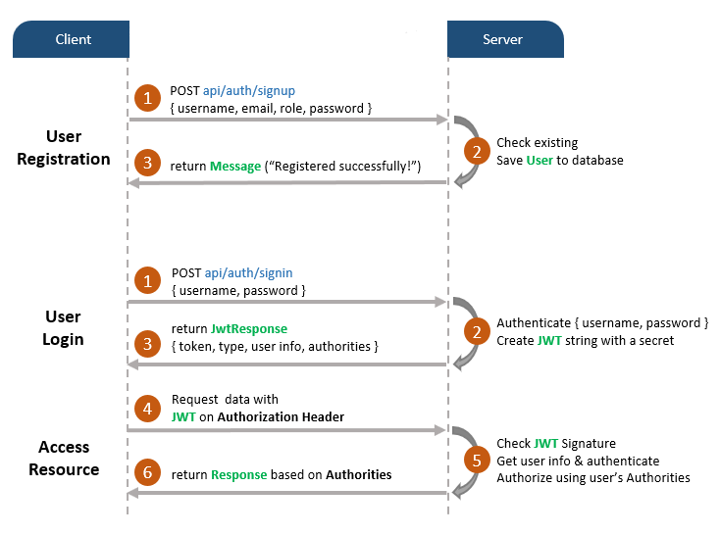

Slide 5
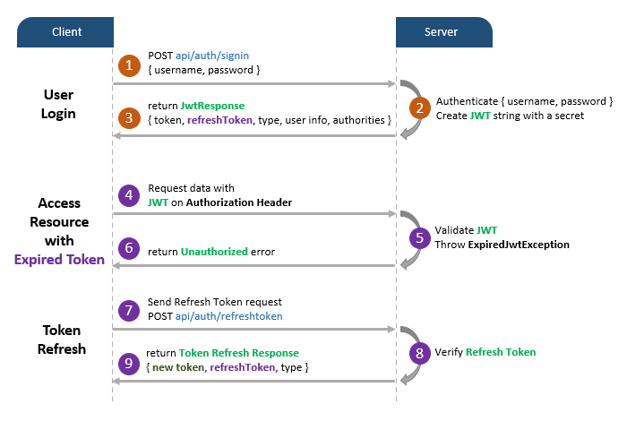

Slide 6
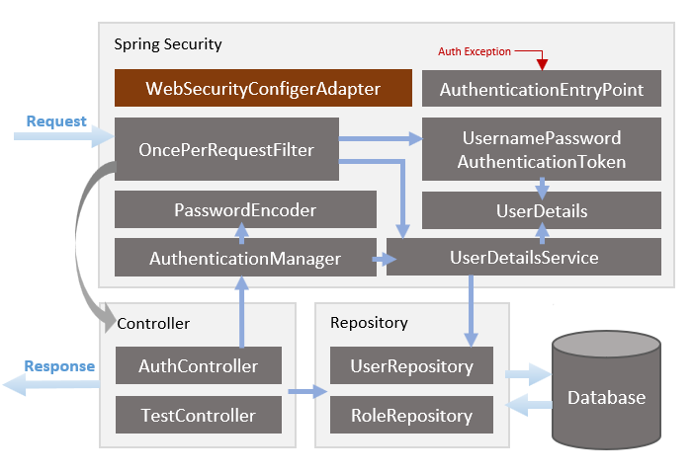

Slide 7
Implementation
Setup Spring Boot Project
Configure Spring Datasource, JPA, App properties
Create models
Implement Repositories & Configure Spring Security
Implement User Details & User Details Service
Filter the Requests
Create JWT Utility class
Handle Authentication Exception

Slide 8
Login
&
Registration
Frontend

Slide 9
Overview
Form data will be validated by front end before being sent to back end
Depending on user’s roles (Admin, User) navigation bar changes its items automatically
Services contain methods for sending HTTP requests & receiving responses

Slide 10
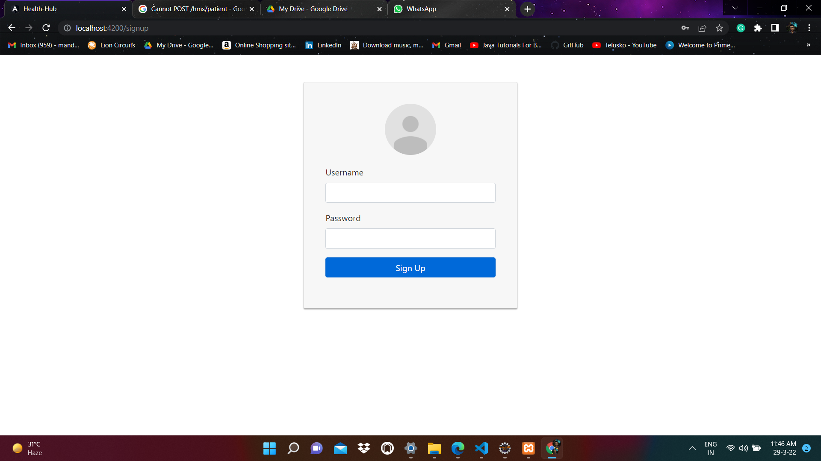
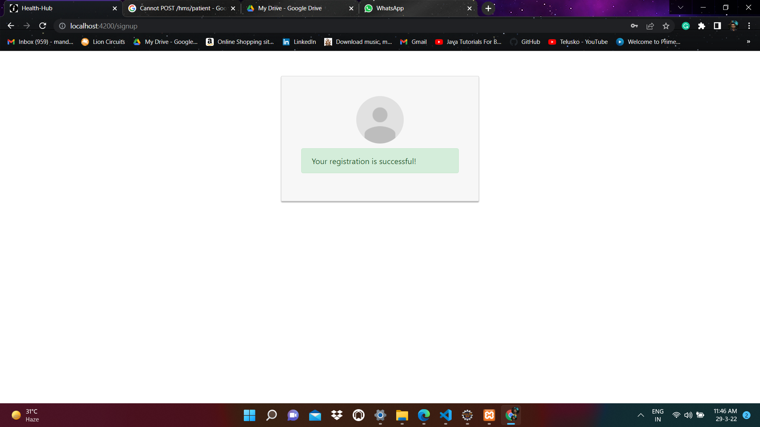
Registration Page

Slide 11
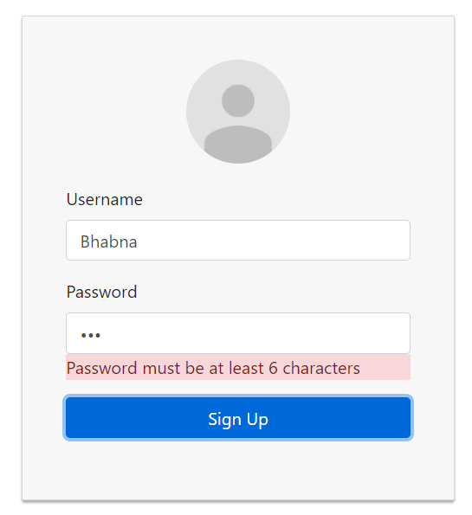
Form Validation

Slide 12
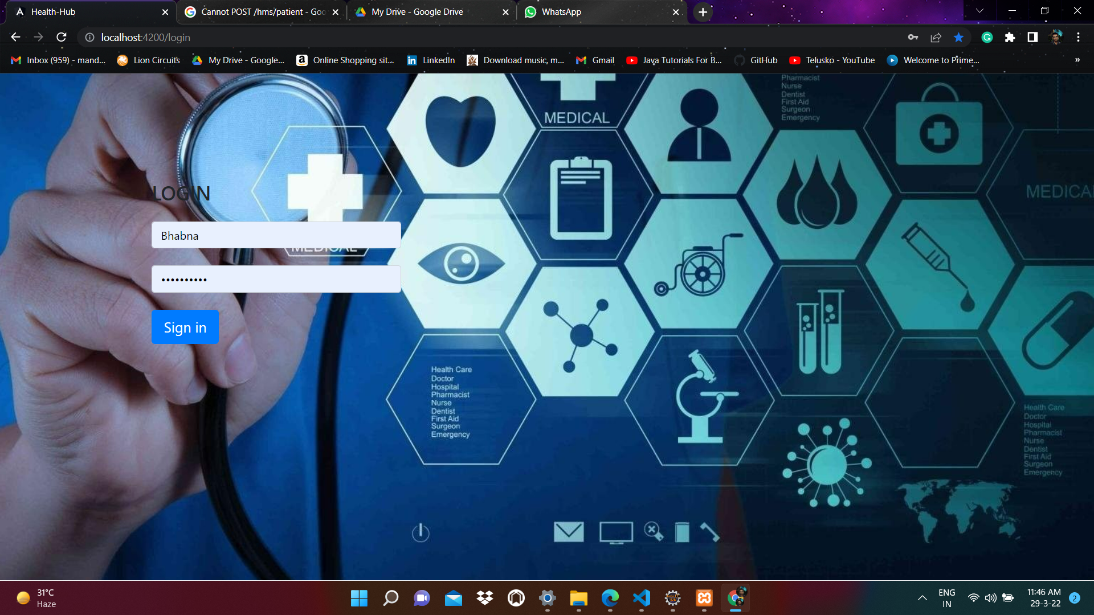
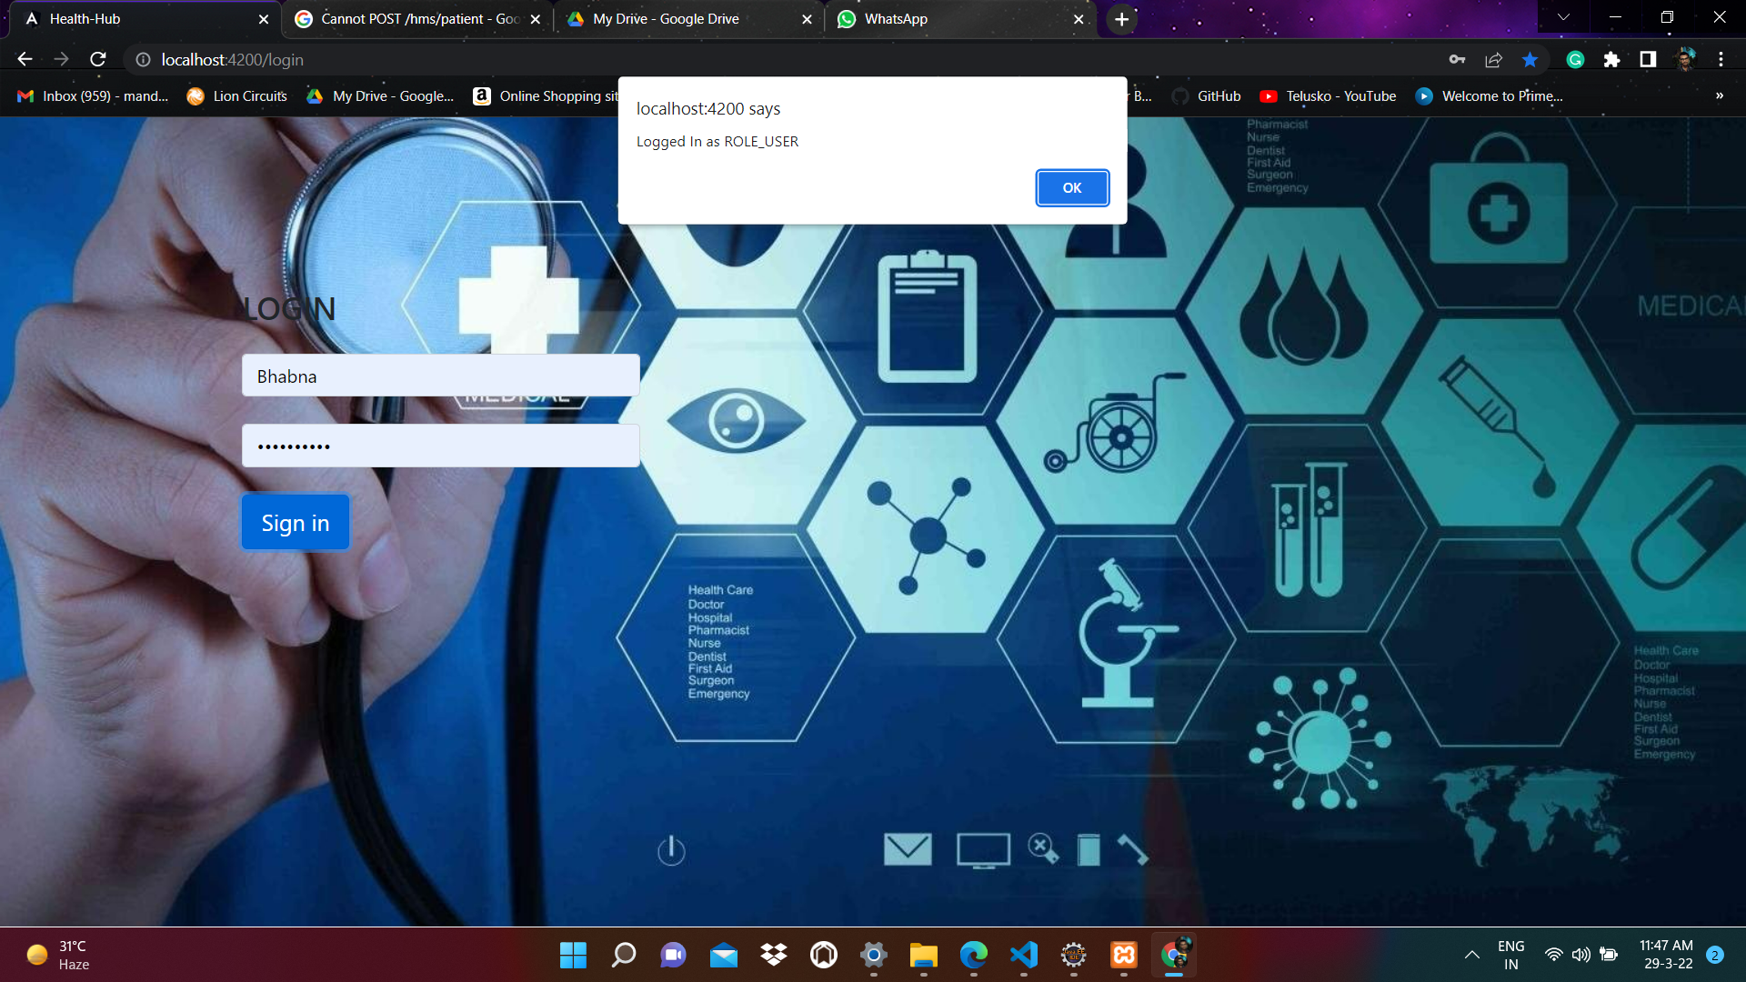
Login Page

Slide 13
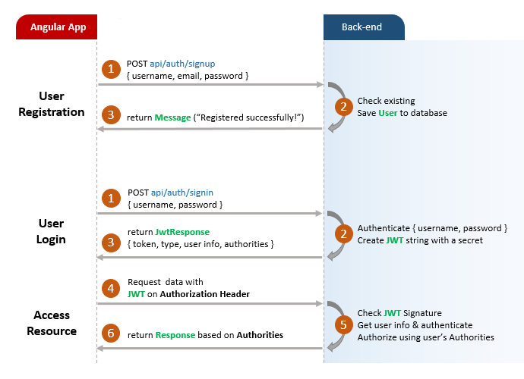
Flow for User Registration and User Login

Slide 14
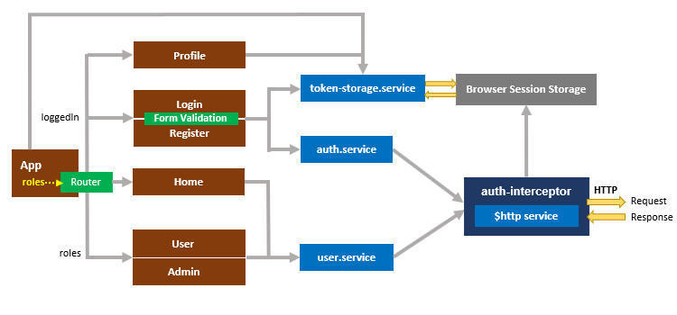
Component diagram with Router & HttpInterceptor

Slide 15
Implementation
Setup App Module
Create Services
Authentication Service
Token Storage Service
Data Service
Http Interceptor
Create components for Authentication
Register Component
Login Component
App Routing Module
App Component

Slide 16
Admin

Slide 17
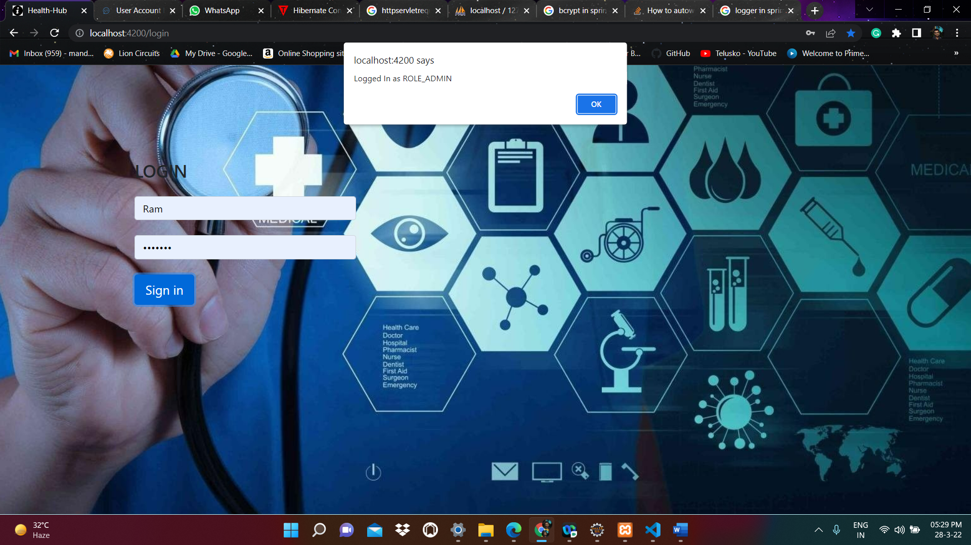
Login As a Admin

Slide 18
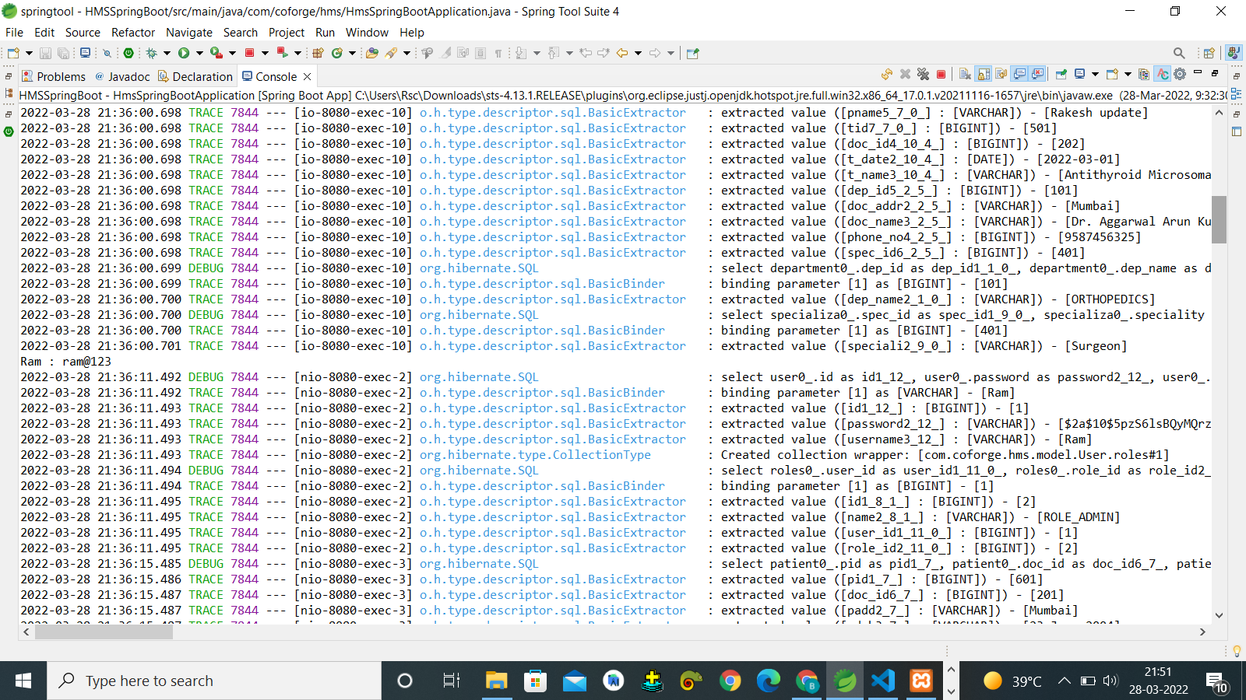
Output of code
user0_.password as password2_12_, user0_.username as username3_12_ from users user0_ where user0_.username=?

Slide 19
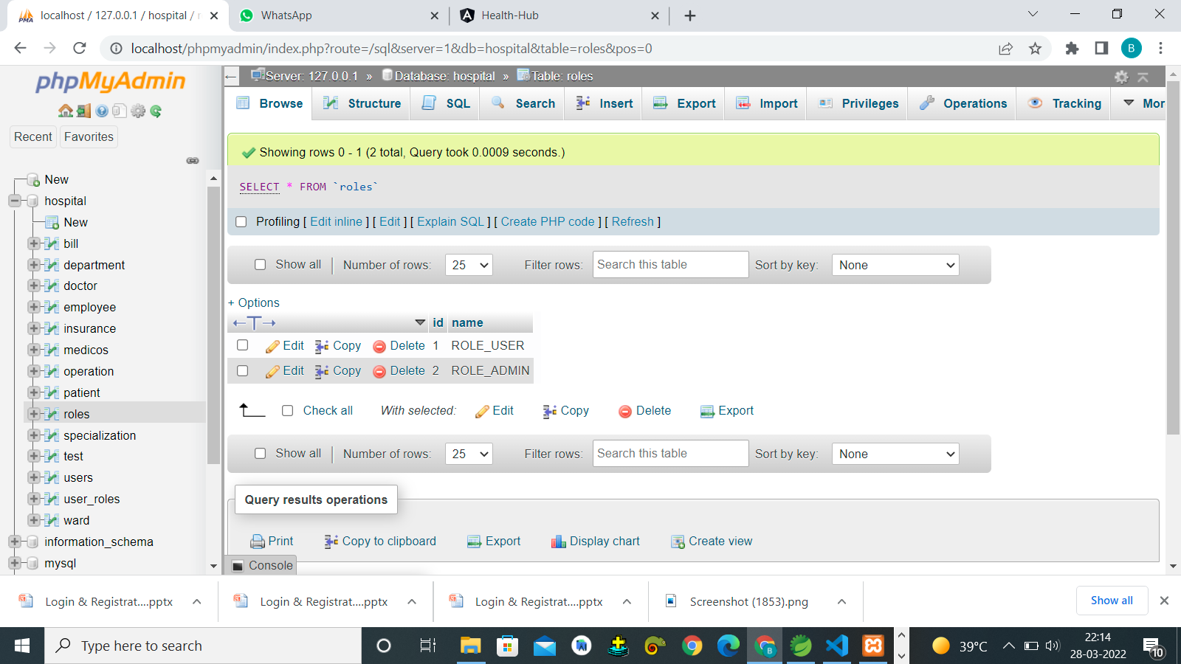
Database

Slide 20
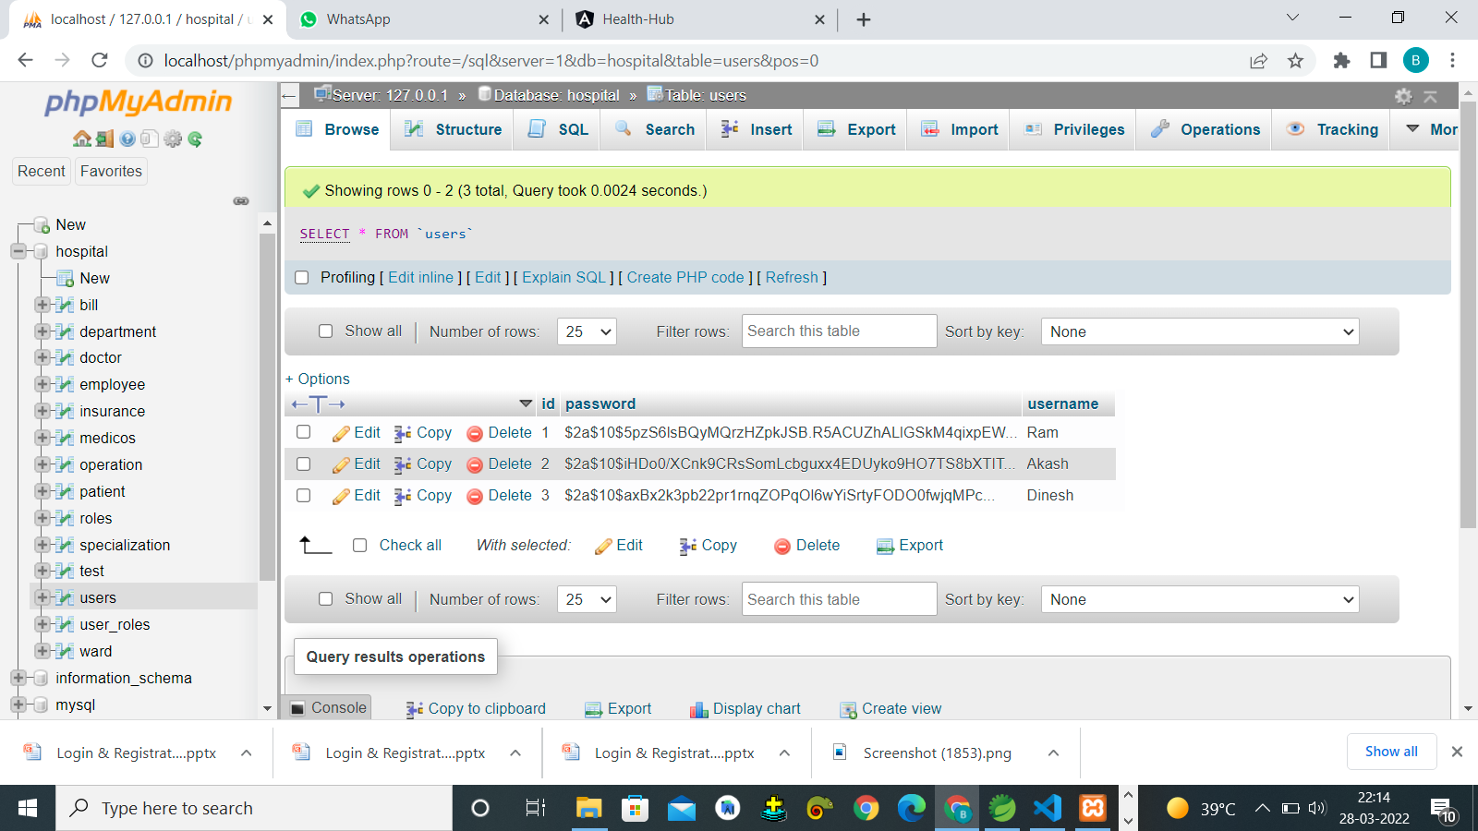
Database

Slide 21
Implementation
Set up the Spring Boot Project
Configure database ,JPA, and Application Properties.
Create Erole and User model.
Create user and role repository.
Successfully login as admin.

Slide 22
Dialect is a class and a bridge between Java JDBC types and SQL types, which contains mapping between java language data type and database datatype. Dialect allows Hibernate to generate SQL optimized for a particular relational database. Hibernate generates queries for the specific database based on the Dialect class.

Slide 23
Hibernate ddl auto (Create, create-drop, validate, update):
hibernate.hbm2ddl.auto Automatically validates or exports schema DDL to the database when the SessionFactory is created. With create-drop, the database schema will be dropped when the SessionFactory is closed explicitly. You can set spring.jpa.hibernate.ddl-auto explicitly and the standard Hibernate property values are none, validate, update, create-drop. Spring Boot chooses a default value for you based on whether it thinks your database is embedded (default create-drop) or not (default none).

Slide 24
ADMIN ACTIVITIES PRESENTATION

Slide 25
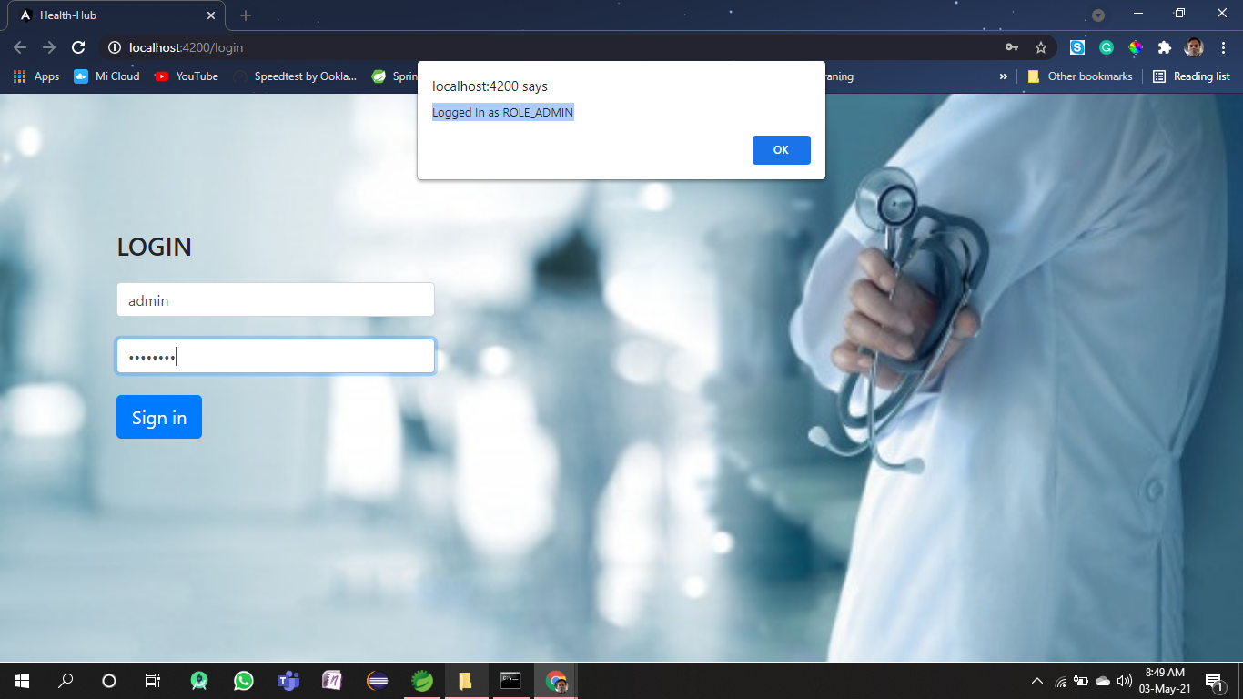
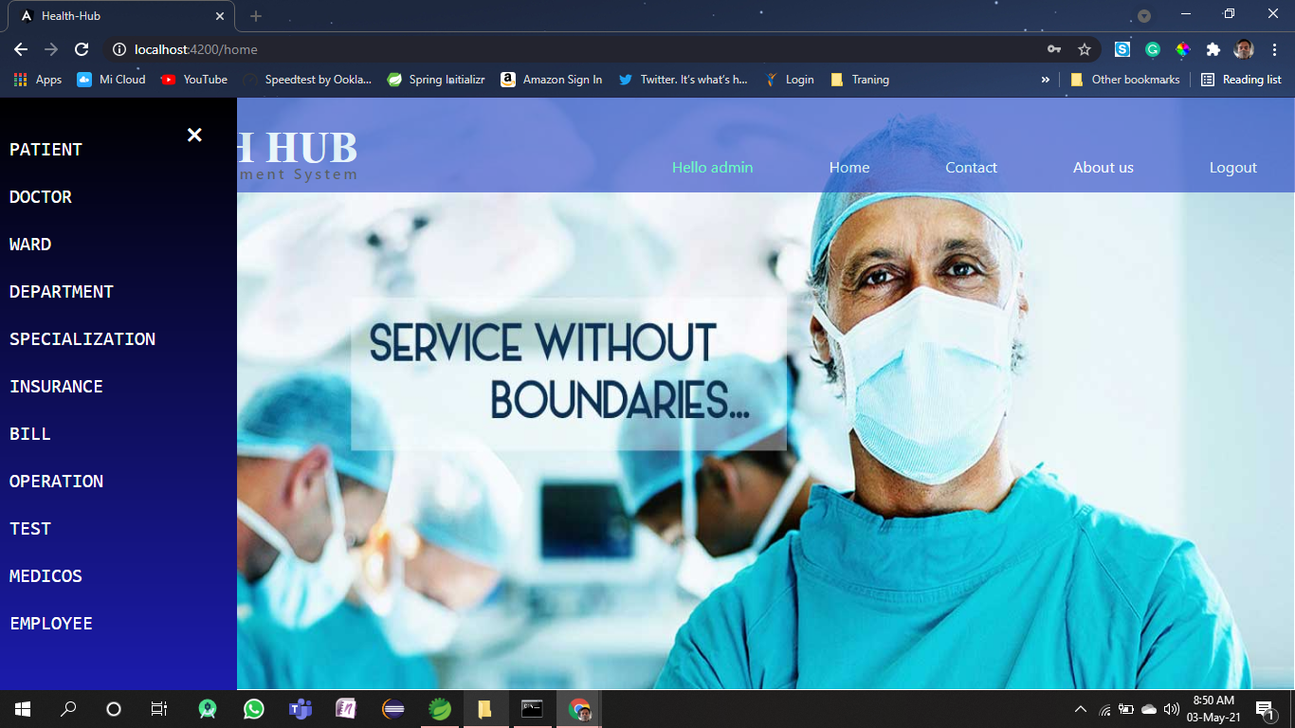
ADMIN LOGIN and ADMIN PANEL

Slide 26
Doctors API
Client
Server
PUT api/doctor
{doctorId,doctorName,doctorAddress,doctorPhoneNO,department,specialization}
1
Check existing and
Save changes to database
Updating Doctor
3
return message(“updated successfully”)
2
1
GET /api/doctor
List of Doctors
Check existing and
Sends List of Doctors from database
3
2
return Doctors List
1
GET /api/doctor/{id}
Doctor with Id
Check existing and
Sends the particular Doctor details with id
3
2
return a doctor's object
1
DELETE /api/doctor/{id}
Delete Doctor
Check existing and
Deletes the Doctor from Database
3
2
return message(“Deleted”)

Slide 27
Patients API
Client
Server
1
GET /api/patient
List of Patients
Check existing and
Sends List of Patients from database
2
3
return List of Patients
1
DELETE /api/patient/{id}
Check existing and
Deletes the Patients from Database
Delete Patient
3
2
return message(“Deleted Successfully”)

Slide 28
Front End Admin

Slide 29
ADMIN:
The Responsibilities of Admin role are as follows:
Managing staff within a facility or department
Managing health informatics, including recordkeeping
Overseeing the financial health of the department or organization
Managing human capital, including policies for hiring, performance reviews, staff schedules, etc.
Ensuring an organization’s compliance with medical and legal regulations and internal policies

Slide 30
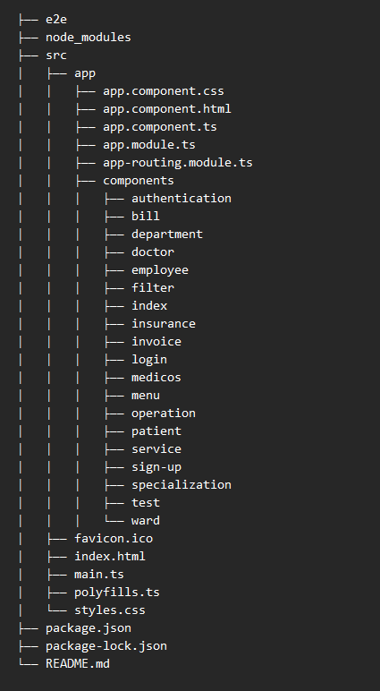
Project Structure:

Slide 31
Admin Login
Register with username and password as Admin.
Once Successfully Registered.
Admin can login with valid username and password.
Login as Admin.

Slide 32
LOGIN AS ADMIN:

Slide 33
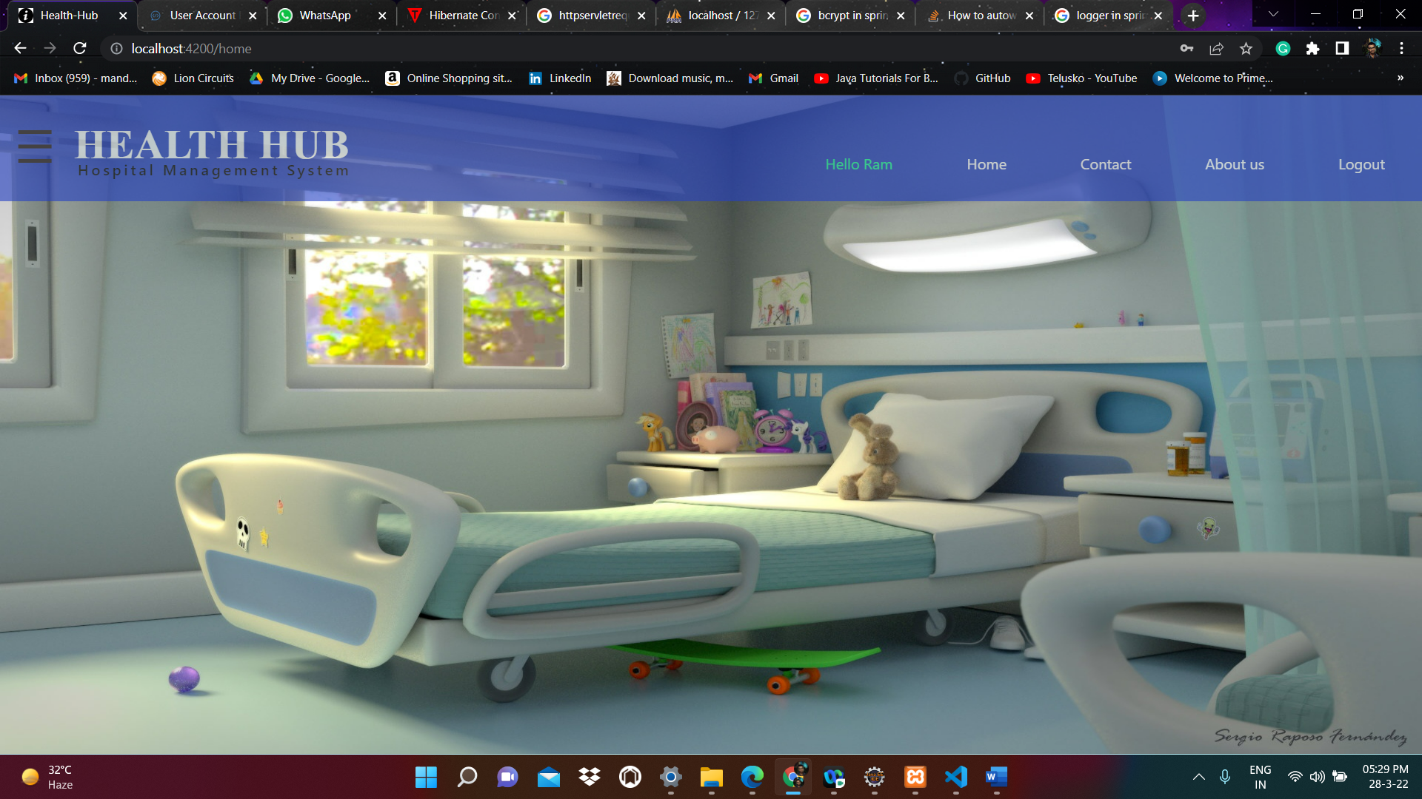
ADMIN PAGE:

Slide 34
Admin Access :
NAV bar :
Home
Contact
About Us
Log Out
Side Bar or Menu can access the list of tabs :
Patient
Doctor
Ward
Department …

Slide 35
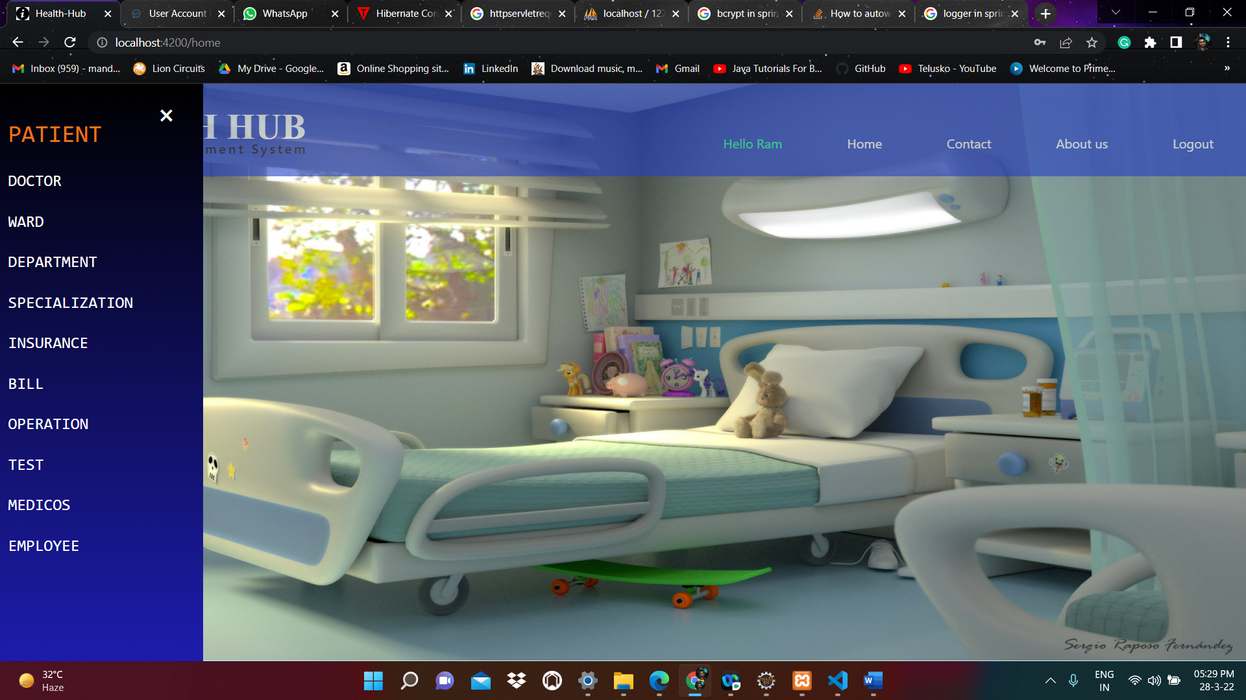
Admin Page:

Slide 36
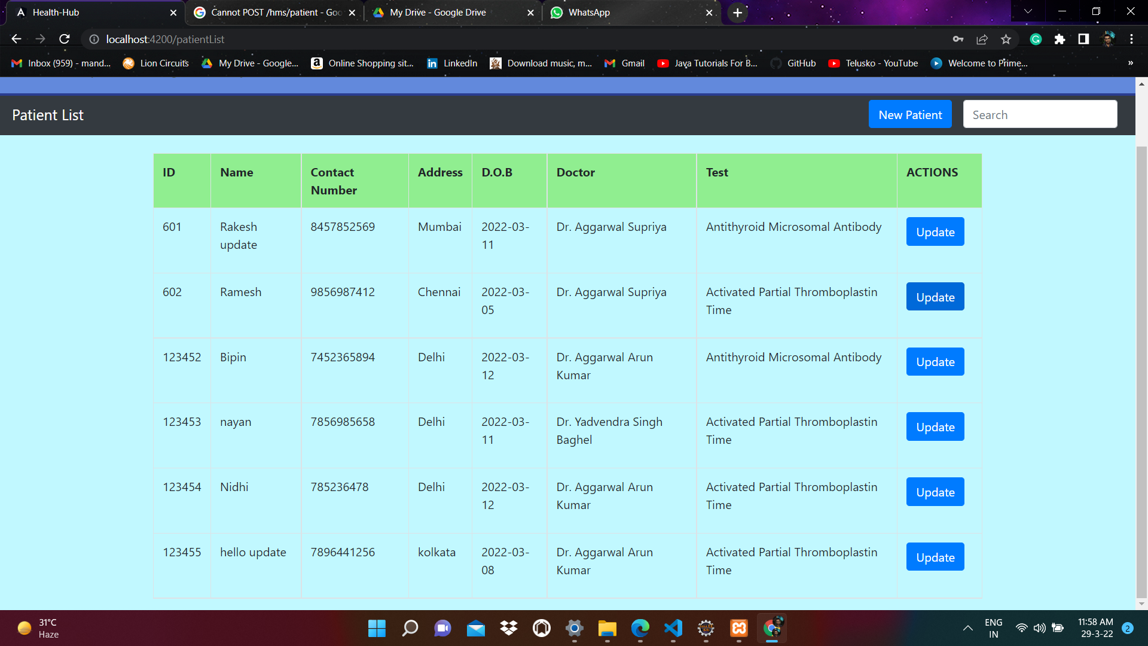
Patient :

Slide 37
Customer (User)
Backend

Slide 38
Overview
User can signup new account, or login with username password
By user’s role(Admin, User), we authorize the user to access resources

Slide 39


Slide 40
PATIENT CONTROLLER METHOD @PostMapping(value="/patient) public ResponseEntity<PatientDTO> addPatient(@RequestBody PatientDTO patient) PatientDTO patDTO = patientServiceImpl.save(patient); return ResponseEntity.ok().body(patDTO); PATIENT SERVICE METHOD public PatientDTO save(PatientDTO patientDTO) { Patient patient = convertDTOtoModel(patientDTO); // convert dto to model for database interaction pRepo.save(patient); return convertModelToDTO(patient);

Slide 41
PATIENT CONTROLLER METHOD @PutMapping (value="/patient/{id public ResponseEntity <PatientDTO> updatePatient (@RequestBody PatientDTO patient), @PathVariable("id") long patId) throws Exception { PatientDTO patDTO = patientServiceImpl.update(patient, patId); return ResponseEntity.ok().body(patDTO); }

Slide 42
PATIENT SERVICE METHOD public PatientDTO update(PatientDTO patient, long pid) throws Exception { PatientDTO cpyPat = getById(pid); cpyPat.setpName(patient.getpName()); cpyPat.setpAdd(patient.getpAdd()); cpyPat.setpDob(patient.getpDob()); cpyPat.setpMobileNo(patient.getpMobileNo()); cpyPat.setDoc(patient.getDoc()); cpyPat.setTest(patient.getTest()); Patient pat = convertDTOtoModel(cpyPat); pRepo.save(pat); //step2 return convertModelToDTO(pat); //step 3 }

Slide 43
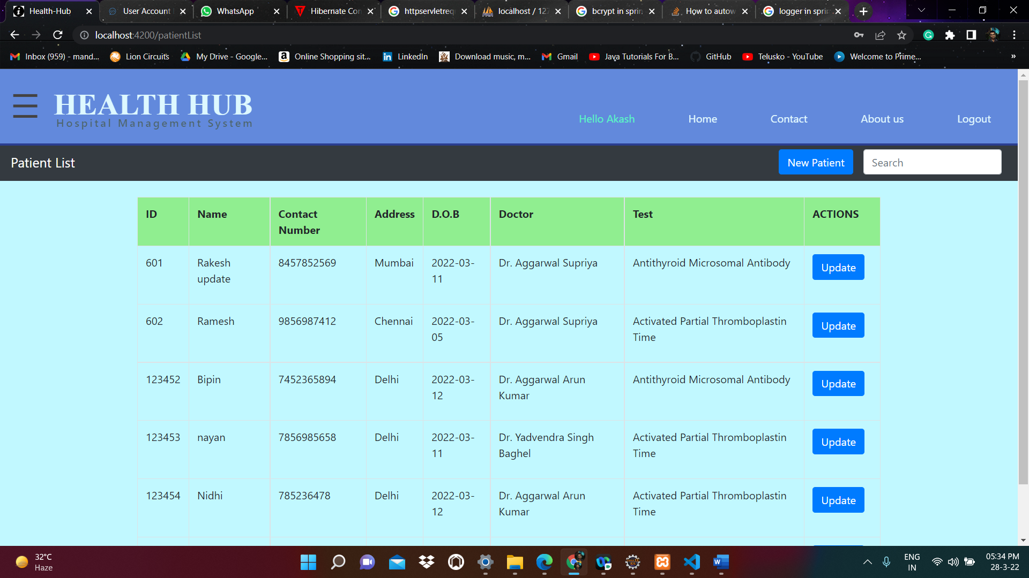

Slide 44
PATIENT CONTROLLER METHOD @DeleteMapping(value="/patient/{id}") public Map<String, Boolean> deletePatient(@PathVariable long id) throws Exception { return patientServiceImpl.delete(id); } PATIENT SERVICE METHOD public PatientDTO getById(long pid) throws Exception { Patient patient = pRepo.findById(pid) .orElseThrow(() -> new Exception("ID NOT FOUND EXCEPTION :::: " + pid)); return convertModelToDTO(patient); }

Slide 45
PATIENT CONTROLLER METHOD @GetMapping(value="/patient/{id public ResponseEntity<PatientDTO> findById(@PathVariable long id) throws Exception { PatientDTO patDTO = patientServiceImpl.getById(id); return ResponseEntity.ok().body(patDTO); } PATIENT SERVICE METHOD public List<PatientDTO> getAll() { List<Patient> patientList = pRepo.findAll(); List<PatientDTO> patientDTOList = new ArrayList<>(); for(Patient patient : patientList) { patientDTOList.add(convertModelToDTO(patient)); } return patientDTOList; }

Slide 46
PATIENT CONTROLLER METHOD @PostMapping(value = "/patient/check") public ResponseEntity<Map<String, Boolean>> isExists(@RequestBody PatientDTO patient){ Map<String, Boolean> res = new HashMap<>(); if(patientServiceImpl.existsByNumber(patient)) { res.put("available", Boolean.TRUE); }else { res.put("available", Boolean.FALSE); } return ResponseEntity.ok().body(res); }

Slide 47
PATIENT SERVICE METHOD public boolean existsByNumber(PatientDTO patient) { Patient pat = pRepo.existsPatientByPMobileNo(patient.getpMobileNo()); if(pat != null) { return true; } else { return false; }

Slide 48
PATIENT REPOSITORY package com.coforge.hms.repository; public interface PatientRepository extends JpaRepository<Patient, Long> { @Query(value = "select * from #{#entityName} p where p.pid=?1", nativeQuery = true) public Patient getById(long pid); @Query(value = "select * from #{#entityName} p where p.pmobile=?1", nativeQuery = true) public Patient existsPatientByPMobileNo(long pMobileNo);

Slide 49
Implementation * Set up the Spring boot project * Configure database ,JPA, and application properties. * Create user models, service and controller

Slide 50
Customer (User)
Frontend

Slide 52
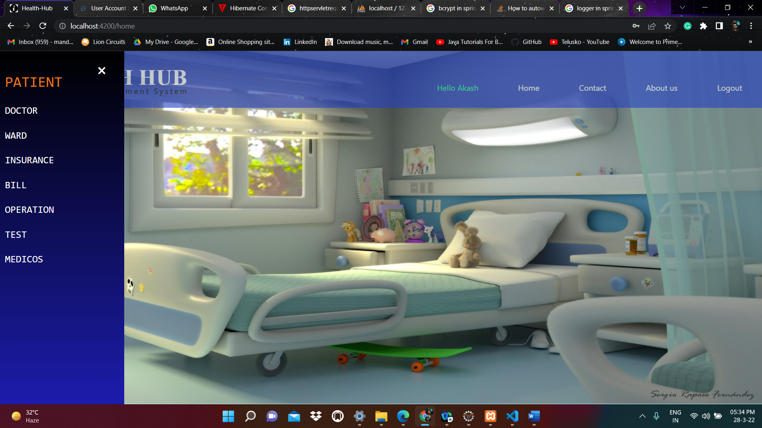

Slide 53


Slide 54
PATIENT SERVICES addPatient(patient: any): Observable<any>{ return this.http.post(`${this.baseUrl}`, patient); } updatePatient(id: number, patient: any): Observable<any> { return this.http.put(`${this.baseUrl}/${id}`, patient); } deletePatient(id: number): Observable<any>{ return this.http.delete(`${this.baseUrl}/${id}`); }

Slide 55
getAllPatient(): Observable<any>{ return this.http.get(`${this.baseUrl}`); } getPatientById(id: number): Observable<any>{ return this.http.get(`${this.baseUrl}/${id}`); } checkIsAvailable(pat:any): Observable<any>{ return this.http.post(`${this.baseUrl}/check`, pat); }

Slide 56
Here we are using some methods in frontend * Get test() * get patient () * onsubmit() * check () * update () * save() * go to next()

Slide 57
Thank you

